Slide 1
EESD28 – Week 2 – Individuals, populations and resources

Slide 2

Individuals and populations.
Axiom 1:
‘All life comes from life’
Time = 0
Individuals = 1
Notes:
In a very strict version of the semantic view. This comparison is done by identifying an isomorphic relationship between model and phenomenon.
A phenomenon that is considered a model of the theory can be used to check if other phenomena are also models of this theory.

Slide 3



Individuals and populations.
Axiom 1:
‘All life comes from life’
Time = 1
Individuals = 2
Notes:
In a very strict version of the semantic view. This comparison is done by identifying an isomorphic relationship between model and phenomenon.
A phenomenon that is considered a model of the theory can be used to check if other phenomena are also models of this theory.

Slide 4




Individuals and populations.
Axiom 1:
‘All life comes from life’
Time = 2
Individuals = 4
Notes:
In a very strict version of the semantic view. This comparison is done by identifying an isomorphic relationship between model and phenomenon.
A phenomenon that is considered a model of the theory can be used to check if other phenomena are also models of this theory.

Slide 5








Individuals and populations.
Axiom 1:
‘All life comes from life’
Time = 3
Individuals = 8
Notes:
In a very strict version of the semantic view. This comparison is done by identifying an isomorphic relationship between model and phenomenon.
A phenomenon that is considered a model of the theory can be used to check if other phenomena are also models of this theory.

Slide 6
Infamous mathematical models!

Slide 7

Isomorphism 1
Time = 10
Individuals = 1024

Slide 8
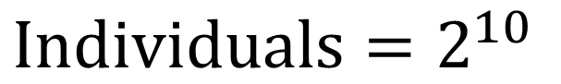
Isomorphism 1
$$Individuals=2^{10}$$
Time = 10
Individuals = 1024

Slide 9
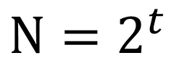
Isomorphism 1
$$N=2^{t}$$
Time = 10
Individuals = 1024

Slide 10
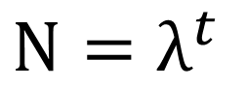
Isomorphism 1
$$N=λ^{t}$$
Time = 10
Individuals = 1024

Slide 11
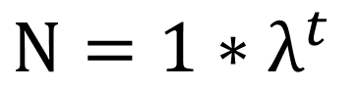
Isomorphism 1
$$N=1∗λ^{t}$$
Time = 10
Individuals = 1024

Slide 12


Isomorphism 1
$$N_{t}=N_{0}∗λ^{t}$$
$$N_{t}=N_{0}∗e^{rt}$$
Time = 10
Individuals = 1024

Slide 13
Isomorphism in modelling is a relationship establishing that two entities are exactly similar in terms of causes and consequences.

Slide 14

$$N_{t}=N_{0}∗λ^{t}$$
Formula for
Discrete population increase

Slide 15
Individuals and populations.
Axiom 1:
‘All life comes from life’
Time = 0
Individuals = 1
Notes:
In a very strict version of the semantic view. This comparison is done by identifying an isomorphic relationship between model and phenomenon.
A phenomenon that is considered a model of the theory can be used to check if other phenomena are also models of this theory.

Slide 16
Individuals and populations.
Axiom 1:
‘All life comes from life’
Time = 0.5
Individuals = 1
Notes:
In a very strict version of the semantic view. This comparison is done by identifying an isomorphic relationship between model and phenomenon.
A phenomenon that is considered a model of the theory can be used to check if other phenomena are also models of this theory.

Slide 17
Individuals and populations.
Axiom 1:
‘All life comes from life’
Time = 0.99
Individuals = 1
Notes:
In a very strict version of the semantic view. This comparison is done by identifying an isomorphic relationship between model and phenomenon.
A phenomenon that is considered a model of the theory can be used to check if other phenomena are also models of this theory.

Slide 18
Individuals and populations.
Axiom 1:
‘All life comes from life’
Time = 1
Individuals = 2
Notes:
In a very strict version of the semantic view. This comparison is done by identifying an isomorphic relationship between model and phenomenon.
A phenomenon that is considered a model of the theory can be used to check if other phenomena are also models of this theory.

Slide 19
Time is continuous

Slide 20

$$N_{t}=N_{0}∗e^{rt}$$
Formula for
continuous population increase

Slide 21
Speed!

Slide 22


Derivatives
T = 0
T = 1
Distance
T = 0
T = 1
Distance

Slide 23
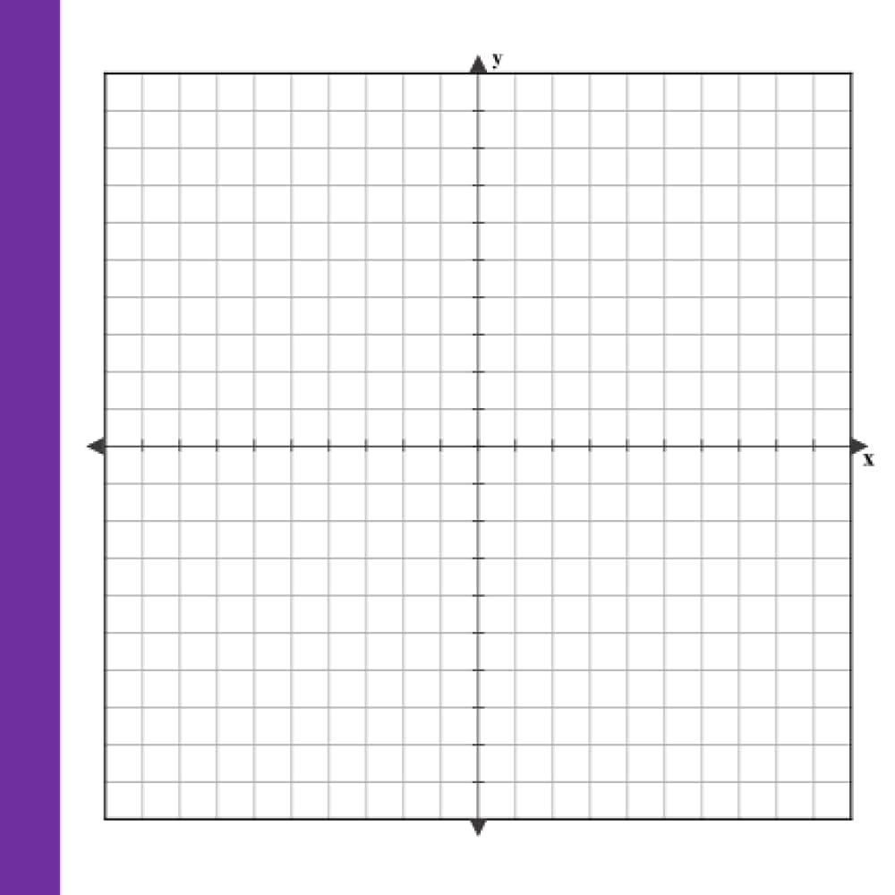
Derivatives
T = 0
T = 1
Speed
Distance
time
T = 0
T = 1
Distance
Speed
time

Slide 24
Derivatives
T = 0
T = 1
Speed
Distance
time
T = 0
T = 1
Distance
Speed
time

Slide 25
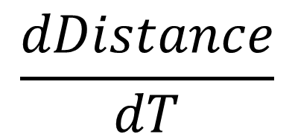
Derivatives
$$\frac{dDistance}{dT}$$
Speed
time

Slide 26
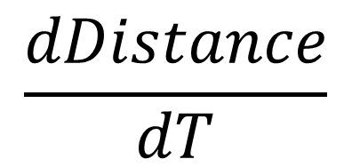
Derivatives
Distance(t)
Distance
time
$$\frac{dDistance}{dT}$$
Speed
time

Slide 27
Derivatives
T = 1
T = 0
Pop size
T = 0
T = 1
Pop size

Slide 28
Is this prediction easy to observe in nature?

Slide 29

Individuals and populations.
Principle 1:
‘All life comes from life’
Principle 2:
‘Pop growth is limited by resource availability’
Notes:
In a very strict version of the semantic view. This comparison is done by identifying an isomorphic relationship between model and phenomenon.
A phenomenon that is considered a model of the theory can be used to check if other phenomena are also models of this theory.

Slide 30
Individuals and populations.
Principle 1:
‘All life comes from life’
Time = 0
Individuals = 1
Principle 2:
‘Pop growth is limited by resource availability’
Notes:
In a very strict version of the semantic view. This comparison is done by identifying an isomorphic relationship between model and phenomenon.
A phenomenon that is considered a model of the theory can be used to check if other phenomena are also models of this theory.

Slide 31
Individuals and populations.
Principle 1:
‘All life comes from life’
Time = 1
Individuals = 2
Principle 2:
‘Pop growth is limited by resource availability’
Notes:
In a very strict version of the semantic view. This comparison is done by identifying an isomorphic relationship between model and phenomenon.
A phenomenon that is considered a model of the theory can be used to check if other phenomena are also models of this theory.

Slide 32
Individuals and populations.
Principle 1:
‘All life comes from life’
Time = 3
Individuals = 4
Principle 2:
‘Pop growth is limited by resource availability’
Notes:
In a very strict version of the semantic view. This comparison is done by identifying an isomorphic relationship between model and phenomenon.
A phenomenon that is considered a model of the theory can be used to check if other phenomena are also models of this theory.

Slide 33
Individuals and populations.
Principle 1:
‘All life comes from life’
Time = 4
Individuals = 8
Principle 2:
‘Pop growth is limited by resource availability’
Notes:
In a very strict version of the semantic view. This comparison is done by identifying an isomorphic relationship between model and phenomenon.
A phenomenon that is considered a model of the theory can be used to check if other phenomena are also models of this theory.

Slide 34
Individuals and populations.
Principle 1:
‘All life comes from life’
Time = 5
Individuals = 10
Principle 2:
‘Pop growth is limited by resource availability’
Notes:
In a very strict version of the semantic view. This comparison is done by identifying an isomorphic relationship between model and phenomenon.
A phenomenon that is considered a model of the theory can be used to check if other phenomena are also models of this theory.

Slide 35
Individuals and populations.
Principle 1:
‘All life comes from life’
Time = 5
Individuals = 10
K=10
Principle 2:
‘Pop growth is limited by resource availability’
Intraspecific competition
Notes:
The growth speed of a pop is given by how fast a population can growth intrinsically (r);
The number of individuals in a given time (N);
A ratio between how many individuals are there and how many individuals can be accommodated (k-n/k).

Slide 36
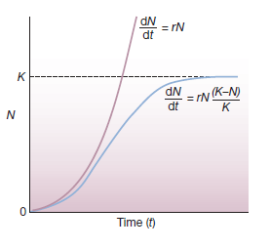
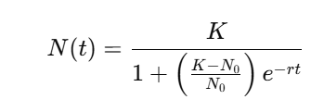
Intraspecific competition.

Slide 37
Organisms are limited by a bunch of things.

Slide 38


Slide 39
Community effects start to form.
K1
Intraspecific competition
N1
Species 1
time
K2
Intraspecific competition
N2
Species 2
time

Slide 40
If they use the same resources...
Intraspecific competition
Species 1
Interspecific competition
Intraspecific competition
Species 2

Slide 41
If they use the same resources...
Principle 1:
‘All life comes from life’
K
Time = 0
Individuals = 1
Principle 2:
‘Pop growth is limited by resource availability’
N
A
0
time
Notes:
In a very strict version of the semantic view. This comparison is done by identifying an isomorphic relationship between model and phenomenon.
A phenomenon that is considered a model of the theory can be used to check if other phenomena are also models of this theory.

Slide 42
If they use the same resources...
Principle 1:
‘All life comes from life’
K
Time = 1
Individuals = 2
Principle 2:
‘Pop growth is limited by resource availability’
N
time
Notes:
In a very strict version of the semantic view. This comparison is done by identifying an isomorphic relationship between model and phenomenon.
A phenomenon that is considered a model of the theory can be used to check if other phenomena are also models of this theory.

Slide 43
If they use the same resources...
Principle 1:
‘All life comes from life’
K
Time = 2
Individuals = 4
Principle 2:
‘Pop growth is limited by resource availability’
N
time
Notes:
In a very strict version of the semantic view. This comparison is done by identifying an isomorphic relationship between model and phenomenon.
A phenomenon that is considered a model of the theory can be used to check if other phenomena are also models of this theory.

Slide 44
If they use the same resources...
Principle 1:
‘All life comes from life’
K
Time = 4
Individuals = 5
Principle 2:
‘Pop growth is limited by resource availability’
N
time
Notes:
Carrying capacity is not defined in the Community, it is defined in the population and environment. So the carrying capacity of the environment for each species is still 10. However it is not being reached because of the effect of intra and interspecific competition.
A phenomenon that is considered a model of the theory can be used to check if other phenomena are also models of this theory.

Slide 45
If they use the same resources...
Principle 1:
‘All life comes from life’
K
Time = 4
Individuals = 5
Principle 2:
‘Pop growth is limited by resource availability’
N
time
Notes:
Carrying capacity is not defined in the Community, it is defined in the population and environment. So the carrying capacity of the environment for each species is still 10. However it is not being reached because of the effect of intra and interspecific competition.
A phenomenon that is considered a model of the theory can be used to check if other phenomena are also models of this theory.

Slide 46
The growth speed function
$$\frac{{dN}_{1}}{dt}=r_{1}N_{1}\frac{K_{1}−(N_{1}+N_{2})}{K_{1}}$$
$$\frac{dN}{dT}=rN\frac{K−N}{K}$$
$$\frac{{dN}_{2}}{dt}=r_{2}N_{2}\frac{K_{2}−(N_{1}+N_{2})}{K_{2}}$$
One Species system
Two species (Sp1, Sp2) that are competitive equivalents

Slide 47
Species may be different

Slide 48
Species may start their competition with different number of individuals
Time = 0
Sp1 = 3
Sp2 = 1
Notes:
In a very strict version of the semantic view. This comparison is done by identifying an isomorphic relationship between model and phenomenon.
A phenomenon that is considered a model of the theory can be used to check if other phenomena are also models of this theory.

Slide 49
Species may start their competition with different number of individuals
Time = 1
Sp1 = 6
Sp2 = 2
Notes:
In a very strict version of the semantic view. This comparison is done by identifying an isomorphic relationship between model and phenomenon.
A phenomenon that is considered a model of the theory can be used to check if other phenomena are also models of this theory.

Slide 50
Species may start their competition with different number of individuals
Time = 2
Sp1 = 8
Sp2 = 2
Notes:
In a very strict version of the semantic view. This comparison is done by identifying an isomorphic relationship between model and phenomenon.
A phenomenon that is considered a model of the theory can be used to check if other phenomena are also models of this theory.

Slide 52
Species may have different reproductive rates
Time = 0
Sp1 = 1
Sp2 = 1
Notes:
In a very strict version of the semantic view. This comparison is done by identifying an isomorphic relationship between model and phenomenon.
A phenomenon that is considered a model of the theory can be used to check if other phenomena are also models of this theory.

Slide 53
Species may start their competition with different number of individuals
Time = 1
Sp1 = 3
Sp2 = 2
Notes:
In a very strict version of the semantic view. This comparison is done by identifying an isomorphic relationship between model and phenomenon.
A phenomenon that is considered a model of the theory can be used to check if other phenomena are also models of this theory.

Slide 54
Species may start their competition with different number of individuals
Time = 2
Sp1 = 7
Sp2 = 3
Notes:
In a very strict version of the semantic view. This comparison is done by identifying an isomorphic relationship between model and phenomenon.
A phenomenon that is considered a model of the theory can be used to check if other phenomena are also models of this theory.

Slide 56
Species may take resources more effectively
Time = 0
Sp1 = 1
Sp2 = 1
Notes:
In a very strict version of the semantic view. This comparison is done by identifying an isomorphic relationship between model and phenomenon.
A phenomenon that is considered a model of the theory can be used to check if other phenomena are also models of this theory.

Slide 57
Species may take resources more efficiently
Time = 1
Sp1 = 2
Sp2 = 2
Notes:
In a very strict version of the semantic view. This comparison is done by identifying an isomorphic relationship between model and phenomenon.
A phenomenon that is considered a model of the theory can be used to check if other phenomena are also models of this theory.

Slide 58
Species may take resources more effectively
Time = 3
Sp1 = 4
Sp2 = 2
Notes:
In a very strict version of the semantic view. This comparison is done by identifying an isomorphic relationship between model and phenomenon.
A phenomenon that is considered a model of the theory can be used to check if other phenomena are also models of this theory.

Slide 59


Slide 60
Competitive Inequivalence terms

Slide 61
The growth speed function
$$\frac{{dN}_{1}}{dt}=r_{1}N_{1}\frac{K_{1}−(N_{1}+N_{2})}{K_{1}}$$
$$\frac{{dN}_{1}}{dt}=r_{1}N_{1}\frac{K_{1}−(N_{1}+{α_{12}N}_{2})}{K_{1}}$$
$$\frac{{dN}_{2}}{dt}=r_{2}N_{2}\frac{K_{2}−(N_{1}+N_{2})}{K_{2}}$$
$$\frac{{dN}_{2}}{dt}=r_{2}N_{2}\frac{K_{2}−(N_{2}+{α_{21}N}_{1})}{K_{2}}$$
Two species (Sp1, Sp2) that are competitive equivalents
Two species (Sp1, Sp2) that are competitive inequivalents.
Lotka-Volterra equations.

Slide 62
Species may take resources more effectively
$α_{12}=\frac{1}{2}$ and $α_{21}=\frac{2}{1}$
Time = 3
Sp1 = 4
Sp2 = 2
Notes:
2 individuals of species 2 have, between them, only the same competitive effect on species 1 as does a
single individual of species 1.

Slide 63
The growth speed function
$$\frac{{dN}_{1}}{dt}=r_{1}N_{1}\frac{K_{1}−(N_{1}+{α_{12}N}_{2})}{K_{1}}$$
$$\frac{{dN}_{2}}{dt}=r_{2}N_{2}\frac{K_{2}−(N_{2}+{α_{21}N}_{1})}{K_{2}}$$
$$\frac{{dN}_{1}}{dt}=2∗1\frac{5−(1+\left(0.5∗1\right))}{5}$$
$$\frac{{dN}_{1}}{dt}=2∗1\frac{10−(1+\left(2∗1\right))}{10}$$
Two species (Sp1, Sp2) that are competitive equivalents
Two species (Sp1, Sp2) that are competitive inequivalents

